Slide 1
21st Century Amblyopia Treatment
The first two decades
Lionel Kowal & Lloyd Bender
RVEEH Melbourne
This talk will be on my website
www.privateeyeclinic.com next week

Slide 2
Amblyopia –
Magnitude of the problem
Leading cause of visual impairment in children
2 to 4%
Impaired fine motor skills
Reduced maximum reading speed
Increased very small lifetime risk of trauma to better eye

Slide 3
Treatment Aims
Improve VA with effective treatment
Do not use ineffective treatment
Treatment has to be acceptable [attractive!?] to patients and parents

Slide 4
BEWARE: ORGANIC DISEASE – will make your life complicated
Can simulate amblyopia
Amblyopia can be superimposed on an organic problem
Always remember to check for an afferent defect
Every ‘stubborn’ or ‘resistant’ or ‘recurrent’ amblyopia can be due to optic n hypoplasia, optic n tumor, craniopharyngioma, …
Don’t withhold amblyopia treatment because there is also some structural problem as well

Slide 5
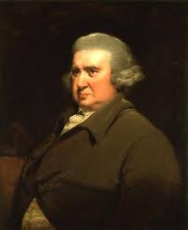
Occlusion therapy for amblyopia
Introduced to UK ophthalmology 300! yrs ago by Charles Darwin’s grandfather
Erasmus Darwin
1731 – 1802

Slide 6
SO many Q’s about occlusion therapy
How much?
For how long?
How to taper?
When should/ -n’t we?
What age is too old?
Are there other treatment options?

Slide 7
‘Evidence based’ treatment recommendations
PEDIG USA
Pediatric Eye Disease Investigator Group
MOTAS UK
Monitored Occlusion Treatment of Amblyopia Study

Slide 8
MOTAS
Study of the effect of treatment that was actually received by the pt
Small numbers
Rigorous monitoring of patching dose with Electronic Occlusion Dose Monitor (ODM)
Parental diaries overestimate actual patching time (by 2 or 3) when monitored with ODM, even when parents know that the diary will be checked against the ODM
Awan M et al. IOVS 2003

Slide 9
PEDIG
Study of the effect of prescribed treatment – cannot determine how much of the prescribed treatment was actually administered
Multiple sites, large study numbers, many publications
Parent diaries are the only monitor of how much of the prescribed treatment was actually given
Notes:
We’re testing the effect of an instruction, not of treatment

Slide 10
prescribed dose ≠ dose actually received
One MOTAS study: 18w of glasses, then patch prescribed for either 6h/d or 12h/d
6h/d: received 4.2 [± 0.5] h/d
12h/d: received 6.2 [± 1.1] h/d
NO significant difference in doses actually received
All PEDIG dosage studies likely to have this defect: prescribed does ≠ dose actually received

Slide 11
SEMINAL SLIDE : Dose response
AGE | DOSE
< 4 y | Less than 3 h/d effective Minimal additional gains with >3 h/d
>4 y | Difference between <3 and 3 - 6 h/d No difference between 3-6 and 6- 12 h/d
>6 y | Less than 3 h/d had little effect Need > 3 h/d
MOTAS

Slide 12
SEMINAL SLIDE :
DOSE RESPONSE @ DIFFERENT AGES
Age years | 1-3h/d | Is 6h/d better than 3h/d?
<4 | Effective | No
4-6 | Effective | Yes >6h/d no better than ≤ 6h/d
>6 | < 3h/d ineffective | Yes

Slide 13
SEMINAL SLIDE : DOSE RESPONSE @ DIFFERENT AGES
1 line gain:
needs ~ 120h occlusion
2 line gain:
4y: needs 170h
6y: needs 236h
MOTAS - IOVS 2007;48: 2589

Slide 14
GLASSES ALONE
WILL IMPROVE ANISOMETROPIC & STRABISMIC AMBLYOPIA
PEDIG: 3 to 7 y
Anisometropic or Strabismic amblyopia
6/12 to 6/75
25+% cured, another 50% ≥ 2 lines better
Took up to 7 mo for glasses to have max effect on amblyopia
MOTAS Br J Ophthalmol 2004;88:1552-1556
65 newly diagnosed amblyopes – mixed types
4 mo of refractive correction
VA improved (p = 0.001) from 6/30 to 6/15

Slide 15
PEDIG patching regimens
VA 6/30 to 6/120
6h/d cf all waking hours are equivalent
4mo: 4+ line improvement
VA 6/12 to 6/24
2h/d cf 6h/d are equivalent
4mo: 2.4 line improvement
Age and severity of amblyopia not
relevant within the limits of these cohorts
Ophthalmology 2003;110:2075
Arch Ophthalmol. 2003;121:603

Slide 16
PEDIG – how to use 1% Atropine
VA 6/12 to 6/24
Daily atropine cf patch 6h/d
6 mo and 2 y followup: no difference
Daily cf weekend Atropine
1/80 Occlusion amblyopia
VA 20/125 to 20/400
Weekend atropine
As effective as patching
Arch Ophthalmol. 2002;120:268
Ophthalmology 2004;111:2076
J AAPOS 2009;13:258

Slide 17
PEDIG - Optical penalization
Arch Ophthalmol. 2009;127:22
Atropine and reduced +
‘Should’ have extra effect
No extra benefit cf atropine alone
Increased risk of occlusion amblyopia

Slide 18
Older children
Glasses vs. glasses plus
VA 6/12 – 6/120
7-12 year old
patch 2-6h/d & daily atropine
acuity improved by ≥ 2 lines in 50%
25% with refractive correction alone
13-17 year old
patch 2-6h/d
Improved acuity in 25%
12mo later: 20% [of the 25%] have regressed
PEDIG – Arch Ophthalmol. 2005;123:437

Slide 19
% of amblyopia deficit corrected
Type | Glasses alone | + Occlusion | Deficit corrected
All | 32 | 47 | 78
Aniso | 44 | 42 | 86
Strab | 30 | 50 | 80
Mixed | 27 | 50 | 77
100% = complete cure of amblyopia
MOTAS

Slide 20
Tentative conclusions
More is better, but (MOTAS) Higher dose rates achieve the best outcome more rapidly but at a risk of accumulating excessive non-therapeutic hours of patching …. patching for all waking hours is almost certainly excessive ....
Younger is better

Slide 21
#1 Dissenter: Bill Scott Iowa
MUCH more is always better
All patients : full-time occlusion FTO
Success : 20/30 or better, or equal VA by ﬁxation pattern.
600 pts followed up after cessation of FTO. 89% followed > 1 y.
W Scott J AAPOS 2005

Slide 22
Scott: EXCEPTIONAL Results
96% attained “success”.
60%: equal visual acuity.
6/12 - 6/30 : 6/9 or ≥ 3 lines improvement:
PEDIG ~80%, Scott 96%
Younger: less occlusion time to endpoint & better visual outcome (P = 0.0001).
Incidence of occlusion amblyopia: 26%. Nearly all treatable.

Slide 23
Why are Scott’s results so much better ?
Is it selection bias?
 | Number | Lost to FU | Strab | Aniso | Mixed
PEDIG | 419 | 5 – 10 % | 38% | 37% | 24%
Scott | 600 | 19% | 73% | 9% | 17%
So – in a cohort skewed to strabismic amblyopia, FTO produces excellent acuity outcomes @ cost of 25% occlusion amblyopia

Slide 24
Recurrence of amblyopia
After ≥ 3 lines acuity improvement
25%: ≥ 2 lines loss @ 12mo
15% in first 6 mo and 10% in second 6 mo
42% after suddenly stopping 6h/d
14% if 6h/d tapered to 2h/d before stopping
PEDIG – J AAPOS 2004;8:420

Slide 25
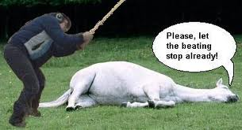
Not getting better: will a treatment surge work?
55 children av age 6.9 y
Mild residual amblyopia
Intensive Rx or weaning?
After 10 w: no difference in VA
Treatment surge ≈ effective in amblyopia as it was in Iraq
PEDIG – Arch Ophthalmol 2011;129:960

Slide 26
Strabismic Amblyopia
Does surgical alignment result in better response to amblyopia therapy?
…or reduce / eliminate need for amblyopia therapy?

Slide 27
Timing of amblyopia therapy relative to strabismus surgery
47 children < 8 y with both amblyopia & esotropia.
26 : amblyopia fully treated before surgery
21 : surgery before completing amblyopia therapy.
5/21 did not require amblyopia therapy after surgery
Alignment ~25% effective for amblyopia
Lam GC et al Ophthalmology Dec 1993

Slide 28
Does alignment result in better response to amblyopia therapy?
Many anecdotal reports that amblyopia therapy becomes more effective when eyes are aligned
NO reliable data

Slide 29
Post Darwinian treatments: 1. Refractive surgery
Surgical safety of LASIK /LASEK / PRK /Phakic IOL / Lens exchange established in selected children
Anisometropia and Ametropia - encouraging results

Slide 30
Results
Larry Tychsen USA
W. Astle, Canada
260 patients
90% within 1.5 D of emmetropia
Variable VA
50% improved fusion and stereopsis
56 eyes (39 patients)
Mean SE -1.73 D
VA improved 1 – 7 lines
No significant improvement in stereopsis
J AAPOS 2005;9:224
J Cataract Refract Surg 2008;34:411

Slide 31
Post Darwinian treatments: 2. Drugs
Levodopa has a 25y history in amblyopia treatment
2010 study: 9 weeks + 3h/d prescribed occlusion
33 older children with residual amblyopia
1/3: 2 line improvement
Well tolerated
Citicholine [similar to L-Dopa; injection]
Anecdotally helpful in some cases of resistant amblyopia
Prozac – Restores plasticity in rat adult visual cortex Science 320,385 (2008)
Arch Ophthalmol. 2010;128(9):1215

Slide 32



21st Century Amblyopia treatment:
The Next Decade
Ben Thompson
Department of Optometry and Vision Science, University of Auckland

Slide 33
rationale
Binocular function may be present but suppressed in amblyopia
Reducing inhibitory interactions within the amblyopic visual system may improve both monocular and binocular visual function

Slide 34
Overcoming Suppression
Can the manipulation of contrast differences between the eyes allow for binocular combination in amblyopia?

Slide 36
Principle Applied to a Portable Device
High contrast game to amblyopic eye
Lower contrast game to other eye
To et al., (2011), IEEE Transactions on Neural Systems and Rehabilitation Engineering, 19, 280-289.
Notes:
8/10 improved acuity, 6/10 improved stereo acuity – 4 measureable stereo for the first time.

Slide 37
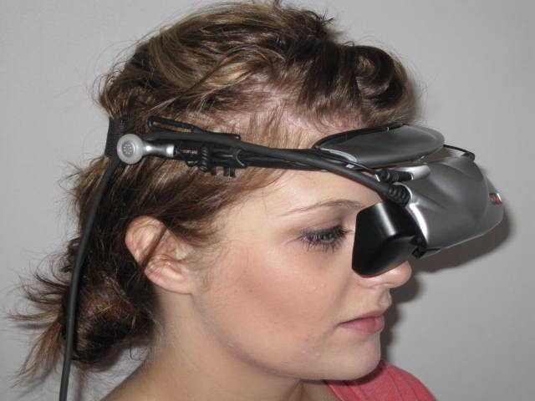
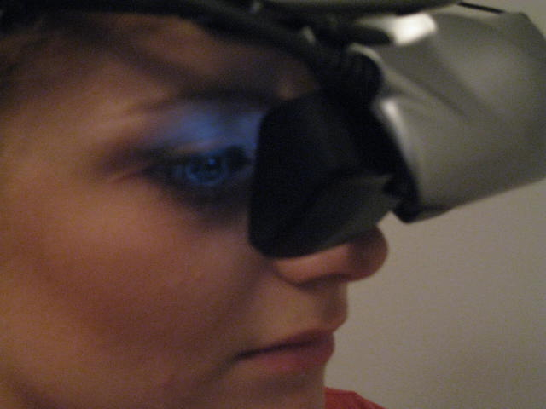
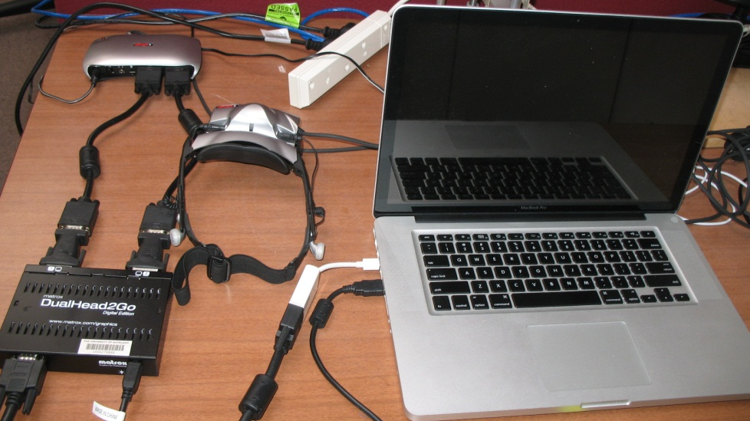
compensating for Suppression in Clinical Settings
Black et al., (2011), Optometry and Vision Science, 88, 334-343.

Slide 39
6/60
6/24
6/10
Notes:
2 – 6 weeks of training. Age range 17-51. 5 aniso 5 strabismic. Improvements stable after 3 months.

Slide 40
Notes:
2 – 6 weeks of training. Age range 17-51. 5 aniso 5 strabismic – 0.015 is 66 seconds of arc.

Slide 42
Take Home
Glasses good
Patching makes it even better
Atropine usually as good as patching
Useful dose response data in kids
Plasticity still there in many older kids/teens
New research promises new treatments

